Slide 1
Appointment Booking System
1
Presented by:
Arpana Maharjan
Heena Maharjan
Neekita Maharjan
Prasansha Bajracharya
Shrija Shrestha
Ujjan Kumar Joshi

Slide 2
Introduction
2
Booking services for its patients
Consultation through messages

Slide 3
Tools Used
3
Frontend
Flutter
Backend/API
Flask
Database
SQLITE 3

Slide 4
Features
4
Can Book an appointment at anytime
Consultation with a doctor through messages
Notify patients of their appointments
Prescriptions

Slide 5
How does it work?
5

Slide 6
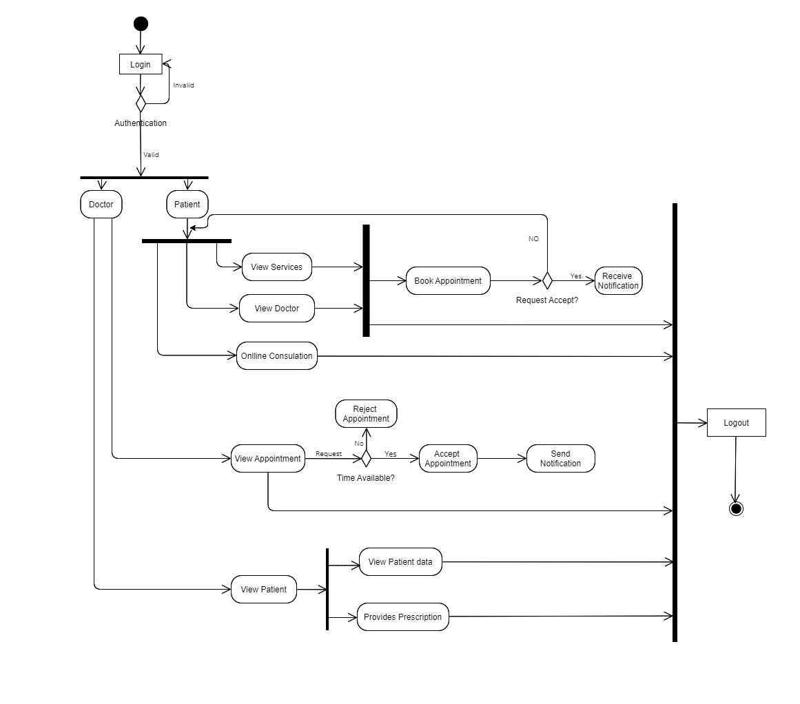
6

Slide 7
Why should you use this application?
7
Minimized waiting times
Can book appointment with a preferred doctor
Application available 24/7
Prescriptions made available
Consultation

Slide 8
DEMO
8

